Slide 1
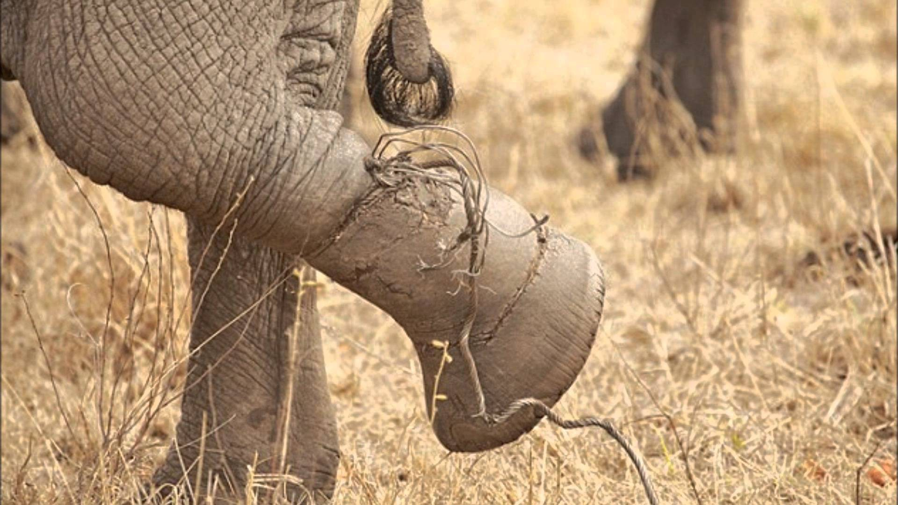
we cannot do something, simply because we failed at it once before? Failure is part of learning; we should never give up the struggle in life.

Slide 2

Marks of two candidates P and Q in the ratio of 2 : 5. If the marks of P is 120, marks of Q will be
(1) 120 (2) 240
(3) 300 (4) 360 (SSC CISF Constable (GD) Exam. 05.06.2011

Slide 3
If a : b = 7 : 9 and b : c = 15 : 7, then what is a:b :
5 : 3 (2) 3 : 5 (3) 7 : 21 (4) 7 : 15
(SSC CGL Prelim Exam. 04.07.1999 (first Sitting)

Slide 4
(1) 3 : 2 : 1 (2) 1 : 2 : 6
(3) 1 : 3 : 6 (4) 2 : 4 : 6
(SSC CGL Prelim Exam. 04.07.1999 (Second Sitting

Slide 5
The ratio of A to B is 4 : 5 and that of B to C is 2 : 3. If A equals 800, C equals
(1) 1000 (2) 1200 (3) 1500 (4) 2000
(SSC CGL Prelim Exam. 04.02.2007(Second Sitting)

Slide 6
If A : B = 3 : 4, B : C = 5 : 7 and C : D = 8 : 9 then A : D is equal to.
(1) 3 : 7 (2) 7 : 3
(3) 21 : 10 (4) 10 : 21
(SSC CGL Prelim Exam 24.02.2002 &13.11.2005 (Middle Zone

Slide 7
(1) 7200 (2) 1800
(3) 1170 (4) 2450
(SSC CGL Tier-II CBE (Exam.) 17.02.2018)

Slide 8
(1) 4 : 6 : 7 : 9 (2) 16 : 24 : 30 : 35
(3) 8 : 12 : 15 : 7 (4) 30 : 35 : 24 : 16
(SSC CGL Prelim Exam 11.05.2009 (First Sitting)

Slide 9
If 2A = 38 = 4C, then A : B : C is :
(1) 2 : 3 : 4 (2) 4 : 3 : 2
(3) 6 : 4 : 3 (4) 3 : 4 : 6
(SSC CHSL DEO & LDC Exam. 28.11.2010 (Ist Sitting)

Slide 10
If 5A = 12B = 13C; find A : B : C.
(1) 60 : 65 : 156 (2) 65 : 156 : 60 (3) 156 : 65 : 60 (4) 13 : 12 : 5
(SSC CGL Tier-I CBE (Exam.) 01.02.2017 (IInd Sitting)

Slide 11
If 6A = 11B = 7C; find A : B : C.
(1) 66 : 42 : 77 (2) 77 : 42 : 66
(3) 42 : 77 : 66 (4) 7: 11 : 6
(SSC CGL Tier-I CBE (Exam.) 30.11.2017 (IInd Sitting)

Slide 12
If 2A = 3B = 5C, what is A : B : C?
(1) 2 : 3 : 5 (2) 5 : 3 : 2
(3) 6 : 10 : 15 (4) 15 : 10 : 6
(SSC CAFTs ASI & Delhi Police SI Online Exam. 04.07.2017 (Ist Sitting

Slide 13
The ratio of two numbers is 3:8 and their difference is 115. The smaller of the two numbers is :
1)184 2)194 3)69 4)59 SSC CGL 04.07.1999

Slide 14
The ratio of three positive numbers is 2:3:5 and the sum of their squares is 608. The three numbers are
1) 2,3,7 2) 20,15,25 3)8,12,20 4) 8,6,10

Slide 15
If a : (b + c) = 1 : 3 and c : (a + b) = 5 : 7, then b : (a + c) is equal to
(1) 1 : 2 (2) 2 : 3
(3) 1 : 3 (4) 2 : 1 SSC CPO S.I. Exam. 03-09-2006

Slide 16
If a : (b + c) = 4:5 and c : (a + b) = 7 :11, then b : (a + c) is equal to
(1) 1 : 2 (2) 1 : 5
(3) 1 : 15 (4) 2 : 1 SSC CPO S.I. Exam. 03-09-2006)

Slide 17
` 3000, ` 2000, ` 1200 (2) ` 3500, ` 1500, ` 1200
(3) ` 2500, ` 2000, ` 1700 (4) ` 2200, ` 3000, ` 1000
(SSC CPO S.I. Exam 05.09.2004)

Slide 20
(1) 2 : 3 : 3 (2) 3 : 4 : 5
(3) 4 : 5 : 6 (4) 9 : 8 : 10
(SSC CGL Prelim Exam. 27.07.2008 (IInd Sitting) & SSC CISF ASI Exam. 29.08.2010)

Slide 21
The fourth proportional to 0.12, 0.21, 8 is:
(1) 8.9 (2) 56
(3) 14 (4) 17
(SSC CGL Prelim Exam. 27.02.2000 (First Sitting)

Slide 22
What is the fourth proportional to 24, 120 and 22?
(1) 110 (2) 120
(3) 100 (4) 90 (SSC CHSL (10 + 2) Tier-I CBE Exam. 21.08.2017

Slide 23
What is the fourth proportional to 189, 273 and 153?
(1) 117 (2) 299 (3) 221 (4) 187
(SSC CGL Tier-I CBE (Exam.) 17.02.2018)

Slide 24
The third proportional to 0.8 and 0.2 is :
0.05 (2) 0.8 (3) 0.4 (4) 0.032
(SSC CHSL DEO & LDC Exam. 21.10.2012 (IInd Sitting

Slide 25
The third proportional of 12 and 18 is
(1) 3 (2) 6
(3) 27 (4) 144
(SSC Graduate Level Tier-II Exam. 29.09.2013)

Slide 26
What is the third proportional to 10 and 20?
(1) 30 (2) 25 (3) 50 (4) 40 (SSC CGL Tier-II CBE (Exam.) 20.02.2018)

Slide 27
` 33,630 are divided among A, B and C in such a manner that the ratio of the amount of A to that of B is 3 : 7 and the ratio of the amount of B to that of C is
6 : 5 The amount of money received by B is
(1) ` 14,868 (2) ` 16,257 (3) ` 13,291 (4) ` 12,395
(SSC CGL Prelim Exam. 04.02.2007 (First Sitting)

Slide 28
(1) 57 (2) 65
(3) 75 (4) 45
(SSC Graduate Level Tier-I Exam. 21.04.2013

Slide 29
The ratio of boys and girls in a college is 5 : 3. If 50 boys leave the college and50 girls join the college, the ratio becomes 9 : 7.
The number of boys in the college is
(1) 300 (2) 400
(3) 500 (4) 600 (SSC CHSL DEO & LDC Exam. 10.11.2013 (Ist Sitting)

Slide 30
The ratio of number of boys and m girls In a school of 720 students is 7 : 5. How many more girls should be admitted to make the ratio 1 : 1?
(1) 90 (2) 120
(3) 220 (4) 240 (SSC CHSL (10+2) Tier-I Exam. 08.09.2016

Slide 31
The number of pupils of a is 55. The ratio of the numbers male pupils to the number of male pupils is 5 : 6. The numbers of female pupils is
11 (2) 25 (3) 30 (4) 35
(SSC CGL Tier-I Exam. 02.09.2016 (Ist Sitting)

Slide 32
In a college union, there are 48 students. The ratio of the number of boys to the number of girls is 5 : 3. The number of girls to be added in the union, so that the ratio of boys to girls in 6 : 5 is
(1) 6 (2) 7 (3) 12 (4) 17
(SSC CGL Tier-II (CBE) Exam. 12.01.2017)

Slide 33
Cross product method :

Slide 34
The ratio between two numbers is 3:4. If each number be increased by 9 , the ratio becomes 18:23. Find the sum of the numbers .

